Slide 1
HUSTLERS
Team members: imanuel c. gemilang, Christian Fernandez, joyce tao, & ricardo flores

Slide 2
Does college degree equal a higher salary?

Slide 3
Data Source
Brent Ozar Unlimited
The 2019, 2018, & 2017 Data Professional Salary Survey Results
https://www.brentozar.com/archive/2019/01/the-2019-data-professional-salary-survey-results/

Slide 4
Does a higher education only proves you can succeed in academia, not in a real-world job.?
Does success in actual work means more than success in education?
Does a higher degree guarantees a particular skill set (which can be translated into work skills?

Slide 5
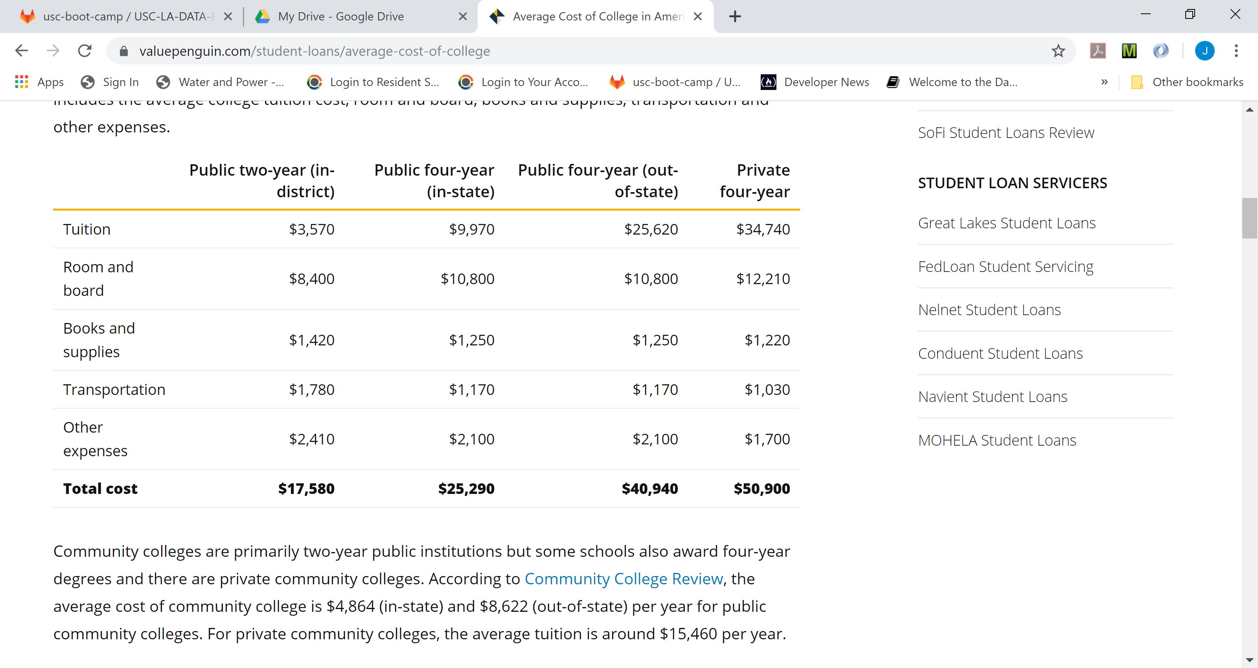
A Breakdown of the Average Costs of College
https://www.valuepenguin.com/student-loans/average-cost-of-college

Slide 6
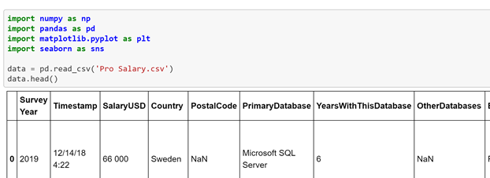
Data Analysis
Jupyter Notebook
Python
Numpy
Pandas
Matplotlib

Slide 7
Employment vs Average Salary
Salary $ | Education
Part-Time | above $250,000.00
Full-Time | Below $100,000.00
Independent | Above $150,000.00

Slide 8
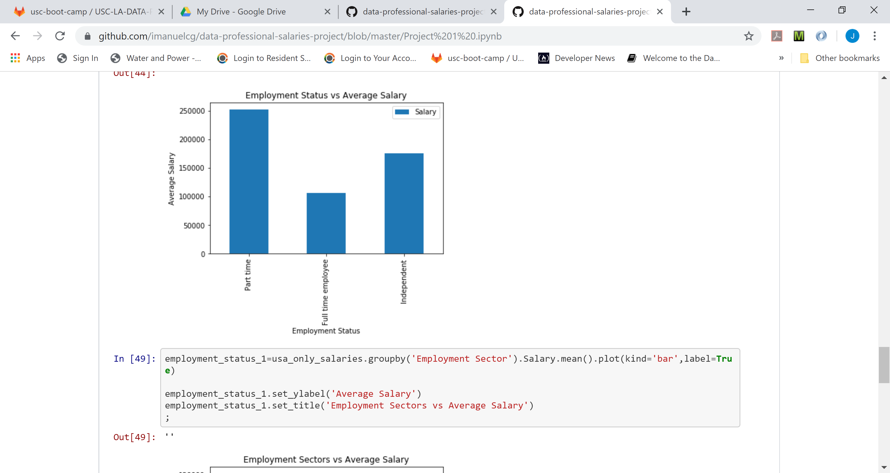
Employment Status vs Average Salary

Slide 9
Employment Status vs Salary
Education | Salary $
Above $120,000.00 | Doctorate/PhD
Under $120,000.00 | None (no degree completed) Associates (2 yeears) Bachelors (4 years) Master

Slide 10
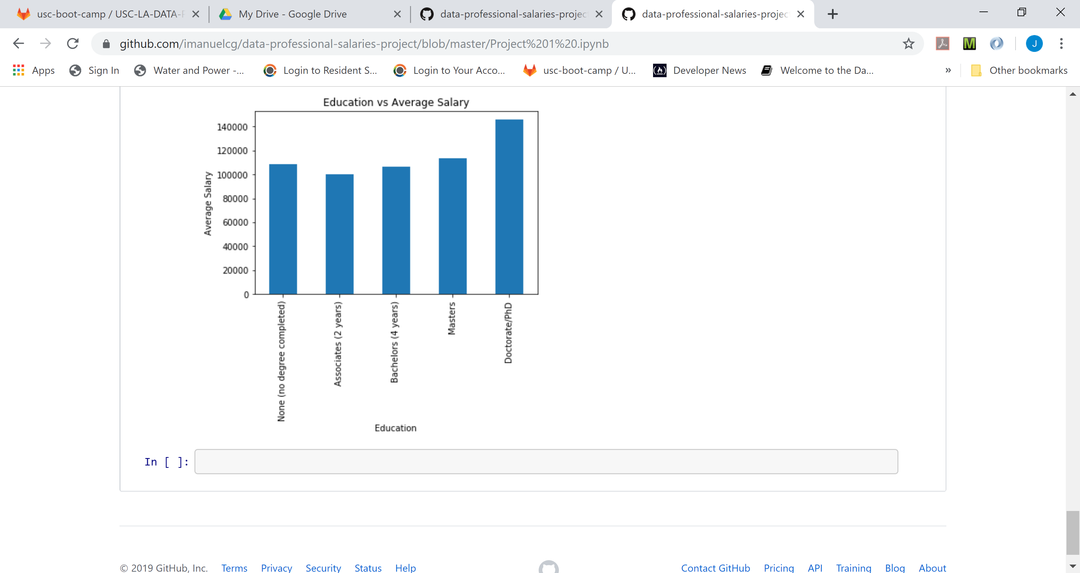
Education vs Average Salary

Slide 11
Employment Sectors vs Average Salary
Top 3 Sector | Average Salary $
Federal Government | $120,000.00
Private Sector | $100,000.00
Non-Profit | $80,000.00

Slide 12
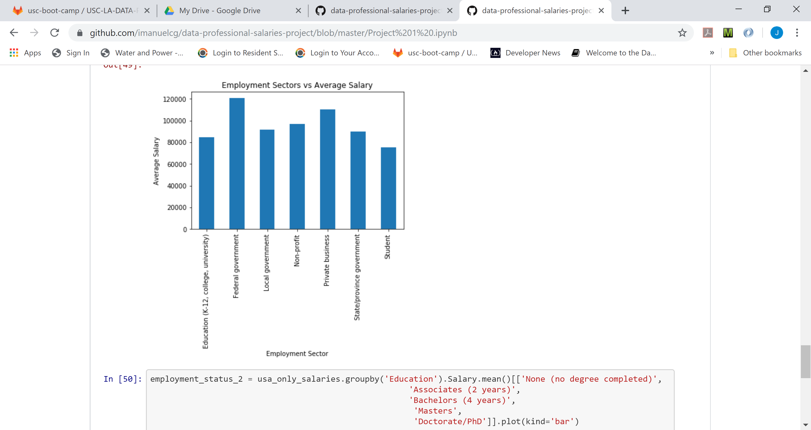
Employment Sectors vs Average Salary

Slide 13
Don’t be addicted to money. Work to learn. Don’t work for money. Work for knowledge.
By: Robert T. Kiyosaki

Slide 14
Questions?

